Slide 1


Green Pace
Security Policy Presentation
Developer: Levi Bajuscik

Slide 2

OVERVIEW: DEFENSE IN DEPTH
This security policy has set a collection of coding standards and best practices to protect our system and the data we collect. This collection of standards make up some of the layers in the defense in depth strategy.

Slide 3
THREATS MATRIX
Likely: Vulnerability is likely to be exploited
Unlikely: Vulnerability is unlikely to be exploited
Priority: Vulnerability is likely to be exploited with a high severity
Low priority: Vulnerability is unlikely to be exploited with a low severity
Likely STD-003-CPP STD-004-CPP STD-005-CPP STD-008-CPP | Priority STD-002-CPP STD-005-CPP STD-008-CPP
Low priority STD-001-CPP STD-006-CPP STD-007-CPP STD-010-CPP | Unlikely STD-001-CPP STD-006-CPP STD-009-CPP STD-010-CPP

Slide 4
10 PRINCIPLES
Validate Input | STD-004-CPP, STD-008-CPP
Heed Compiler Warnings | STD-001-CPP, STD-002-CPP, STD-003-CPP
Architect and Design for Security Policies | STD-007-CPP, STD-009-CPP
Keep It Simple | STD-009-CPP, STD-010-CPP
Default Deny
Adhere to The Principle of Least Privilege
Sanitize Data Sent to Other Systems | STD-004-CPP
Practice Defense in Depth | STD-007-CPP
Use Effective Quality Assurance Techniques | STD-005-CPP, STD-006-CPP, STD-007-CPP
Adopt a Secure Coding Standard | STD-006-CPP

Slide 5
CODING STANDARDS
1 | STD-008-CPP | Ensure that operations on signed integers do not result in overflow
2 | STD-002-CPP | Do not read uninitialized memory
3 | STD-005-CPP | Do not access freed memory
4 | STD-004-CPP | Sanitize data passed to complex subsystems
5 | STD-09-CPP | Do not modify the standard namespaces
6 | STD-010-CPP | Write constructor member initializers in the canonical order
7 | STD-001-CPP | Obey the one-definition rule
8 | STD-007-CPP | Handle all exceptions
9 | STD-003-CPP | Do not attempt to modify string literals
10 | STD-006-CPP | Use a static assertion to test the value of a constant expression

Slide 6
ENCRYPTION POLICIES
Encryption at rest | Encryption at rest is when stored data, like on a smartphone or hard drive, is in an encrypted state by using encryption algorithms. Encryption algorithms like advanced encryption standard (AES) are commonly used.
Encryption in flight | Encryption in flight refers to data being in an encrypted state as it is in transit from source to destination, typically over a network. A widely adopted protocol for this is transport layer security (TLS).
Encryption in use | Encryption in use is the encryption of data while the system is using it in some way (i.e., Processing, updating, reading, etc.)

Slide 7
TRIPLE-A POLICIES
Authentication | Authentication is the process of confirming a user is who they say they are. This is typically done through a username and password system, or biometrics, fingerprints, etc.. This step is essentially asking "Who are you?" Without this step being done first, it makes the next two become that much harder to be effective because they rely on the proper verification of user credentials.
Authorization | Authorization is simple the set of attributes a user is authorized to perform within the system. This step is asking "What are you allowed to do?" Role-based access control (RBAC) - Level of access defined by roles Attribute-based access control (ABAC) - Level of access defined by attributes or characteristics
Accounting | Accounting is the recording and monitoring of user's actions on the network and or application. This step is asking "What did you do?" Security information & event management (SIEM) system – Manages and stores logs

Slide 8
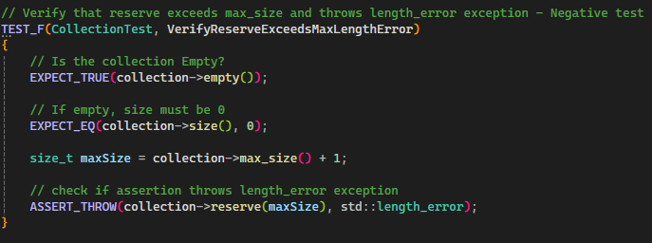
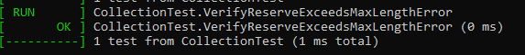
Unit Testing
VerifyReserveExceedsMaxLengthError

Slide 9
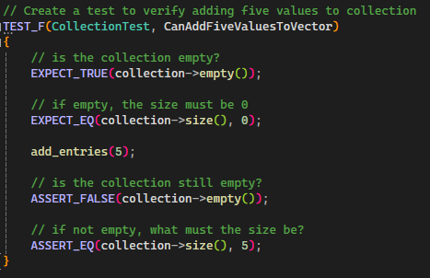
Unit Testing
CanAddFiveValuesToVector

Slide 10
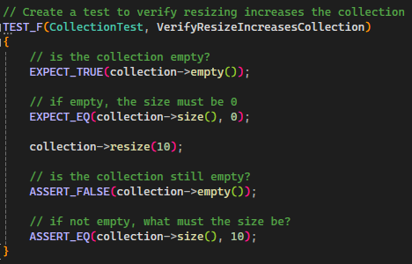
Unit Testing
VerifyResizeIncreasesCollection

Slide 11
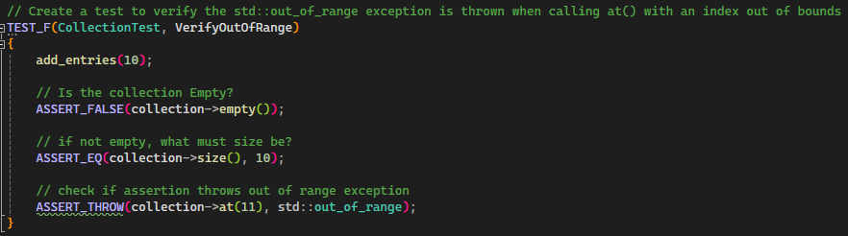
Unit Testing
VerifyOutOfRange

Slide 12

AUTOMATION SUMMARY
Shift left, so automated security tools are used as early as possible and in as many stages as possible.

Slide 13
TOOLS
Assess and plan – Threat modeling tools
Design – IDE/security plugins and Vulnerability scanning tools
Build – SAST tools, compilers, and dependency checks
Verify and test – DAST, test coverage tool, unit testing frameworks, and fuzz tests
Monitor and detect – SIEM and ISCM

Slide 14
RISKS AND BENEFITS
There is a solid consensus among software security professionals that security should be done as early as possible, the earlier the better
Benefits of acting now:
Easier to implement from the beginning
Catch vulnerabilities early
Enhances overall application resilience
weaknesses of acting now:
Steep learning curve
Inadequate training
Resistance to cultural shift

Slide 15
RECOMMENDATIONS
Foster the DevsecOps culture as it takes time, training, and devotion to fully adopt
Regular audits to identify where security may still be lacking
Better understanding of Green Pace's risk appetite
What is a Security Policy? Types, Components and Examples
Determine the roles or attributes for access control
Clear classification of data that we will be collecting
Key elements of an information security policy | Infosec

Slide 16
CONCLUSIONS
Security must be considered from the very beginning and needs to have a proactive approach
DevSecOps training and culture must be embraced
Conduct regular gap analysis
How to Identify and Address Gaps in Your Cybersecurity Compliance With a Cybersecurity Gap Analysis
The security policy needs to be reviewed regularly and updated when necessary

Slide 17
REFERENCES
DevSecOps Fundamentals Guidebook: DevSecOps Tools & Activities . (2021, March). https://dl.dod.cyber.mil/wp-content/uploads/devsecops/pdf/DevSecOpsTools-ActivitiesGuidebook.pdf
Nolan, J. (2025, March 14). Importance of auditing user account & security permissions. Sourcepass. https://blog.sourcepass.com/sourcepass-blog/why-your-business-needs-to-audit-user-account-and-security-permissions
Jones, E. (2025, June 18). How to identify and address gaps in your cybersecurity compliance with a cybersecurity gap analysis. Warren Averett CPAs & Advisors. https://warrenaverett.com/insights/cybersecurity-gap-analysis/
Grimmick, R. (2024, November 13). What is a security policy? definition, elements, and examples. Varonis. https://www.varonis.com/blog/what-is-a-security-policy

